Slide 1
MIS 637 : Data Analytics and Machine Learning
Predicting Loan approval using Decision Tree and Logistic Regression
By: Eric Arrieta, Swetha Nalanagula, Nirmal Rajan & Lihan Tu Supervised By: Prof. Mahmoud Daneshmand

Slide 2

Introduction
One of the key functions of banks and financial institutions is to provide loans to individuals and businesses
Not all loan applicants, however, are able to fulfill the requirements for loan approval
Banks and other financial institutions can make better decisions and lower their risk of loan defaults by utilizing machine learning models to predict whether to approve a loan or not
As a result, the financial institutions may process loans more quickly and be more profitable

Slide 3
Objectives of the Project
The main goal of this project is to predict loan application approval via machine learning models
Two models, Decision Tree and Logistic Regression, will be developed for the purpose of the project
We are strictly following the steps under the Cross-Industry Standard Process (CRISP-DM) throughout the entire project
The software we would use for the project are Python and Jupyter Notebook. Python has many built-in packages, such as pandas, numpy, matplotlib, seaborn and scikit-learn, that help with data analysis and machine learning
By doing this project, we hope to assist financial institutions in making more precise and informed decisions about loan applications
The project will also provide us with the chance to learn how various machine learning models perform on classification tasks

Slide 4
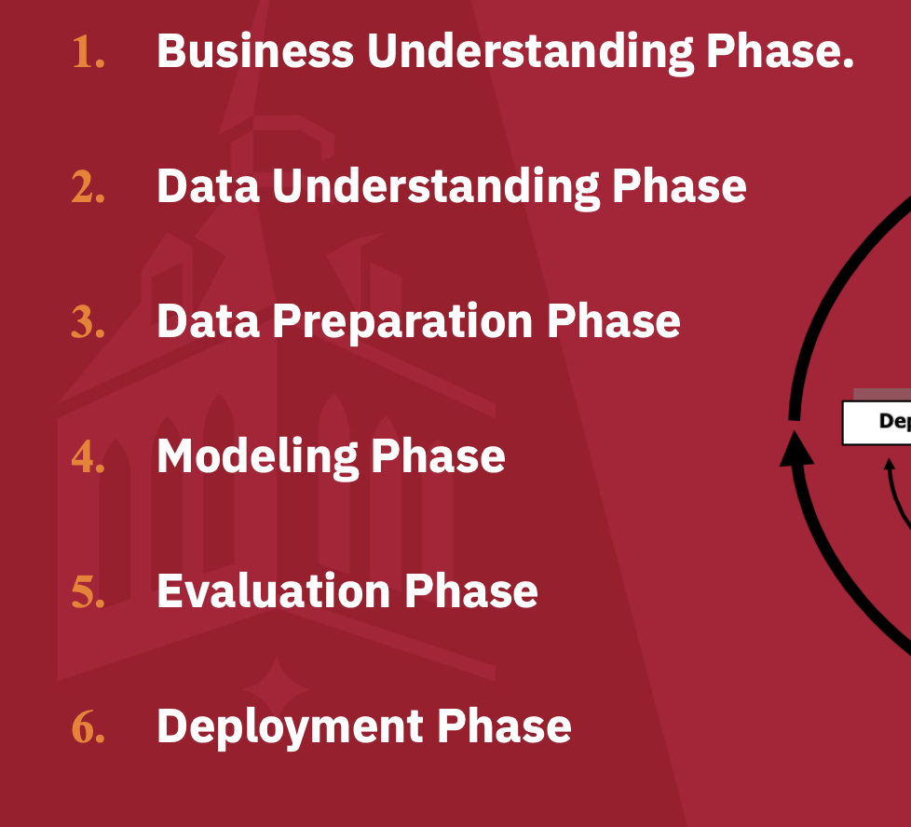
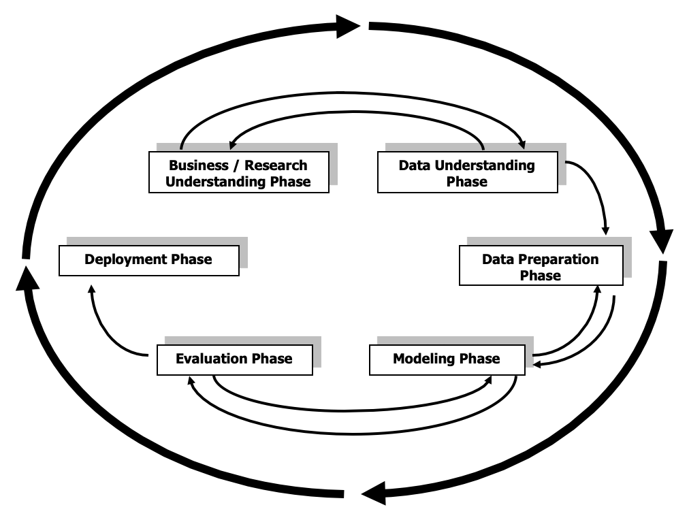
Cross-Industry Standard Process (CRISP-DM)

Slide 5
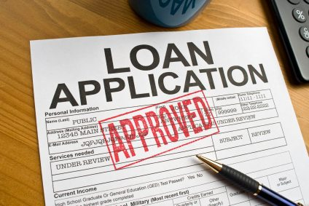
Business Understanding
Profound Question: Determine if a loan applicant will get their loan approved or not
Goal of Project: Building Decision Tree and Logistic Regression Models to predict if a loan application will be approved or not
Context of the Question: With machine learning this could help the bank(s) automate the loan approval process. This will help predict the likelihood of a new client getting their loan approved based on various factors such as credit history, income, education and other pertinent data points
Key Stakeholders: Bank executives, loan managers at bank, database managers at bank, loan applicants, and all other relevant parties

Slide 6
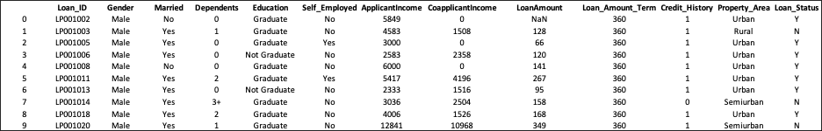
Data Understanding
Data Source: The data set was obtained from www.kaggle.com
Dataset Details: The dataset contains 614 loan applications. The dataset has 13 attributes. 12 are independent attributes and 1 is the target attribute. The target attribute is the one that classifies the applicants if they got approved or not for the loan, Loan_Status.
Dataset Sample below:

Slide 7
Data Understanding Cont’d
Dataset attributes description:
Loan_ID : Unique Loan ID
Gender : Male/ Female
Married : Applicant married (Y/N)
Dependents : Number of dependents
Education : Applicant Education (Graduate/ Under Graduate)
Self_Employed : Self employed (Y/N)
ApplicantIncome : Applicant income
CoapplicantIncome : Coapplicant income
LoanAmount : Loan amount in thousands
Loan_Amount_Term : Term of loan in months
Credit_History : 1 - has all debts paid, 0 - not paid
Property_Area : Urban/ Semi Urban/ Rural
Loan_Status : (Target) Loan approved (Y/N)

Slide 8
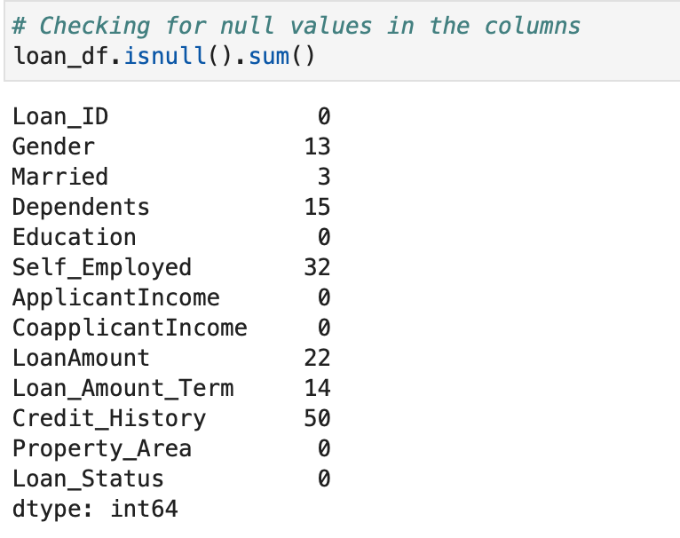
Data Understanding - Data Quality
Figure below shows the number of null values for each variable

Slide 9
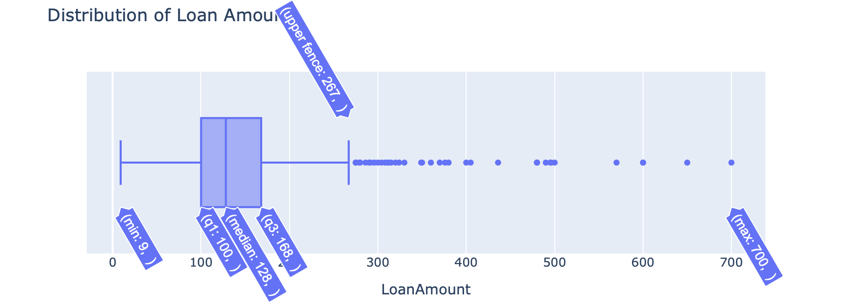
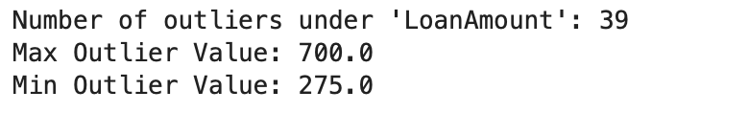
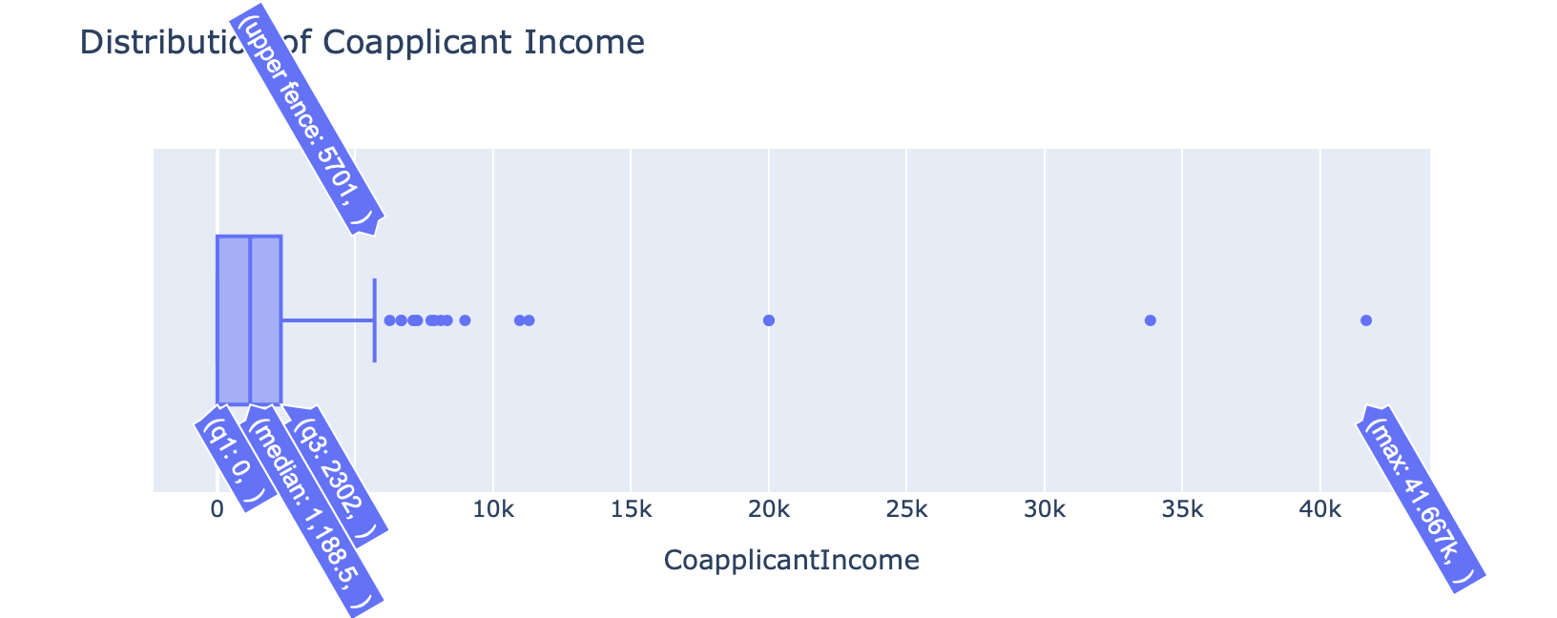
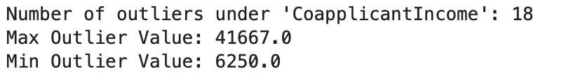
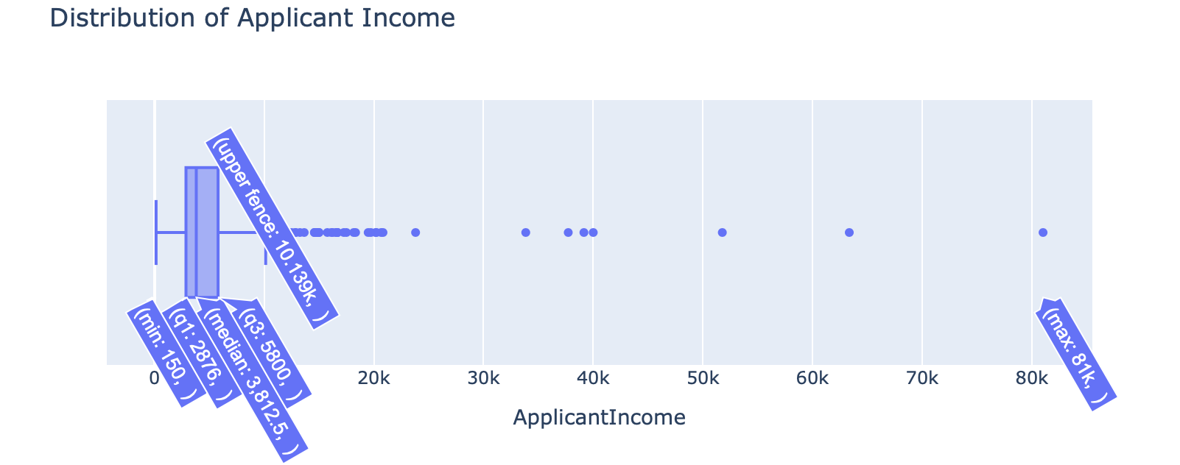
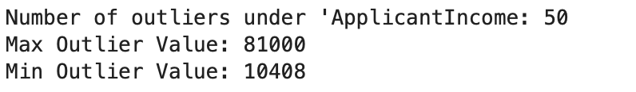
Data Understanding - Data Quality Cont’d
Figure below shows the number of outliers for each numerical variable

Slide 10
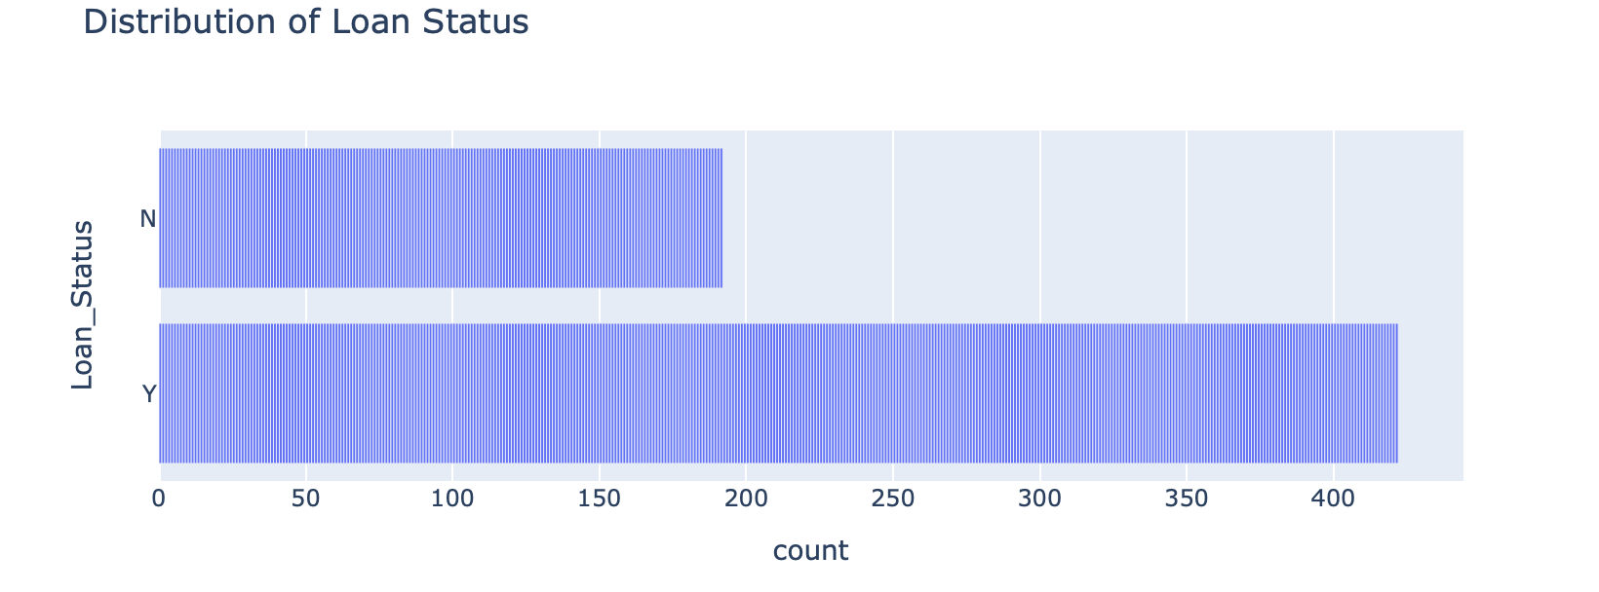
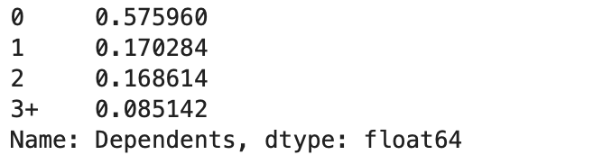
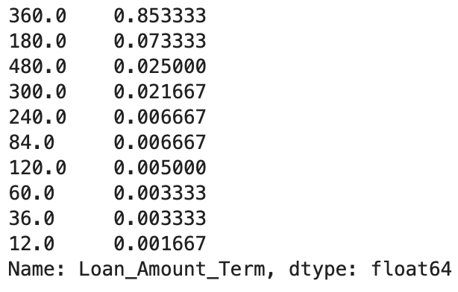
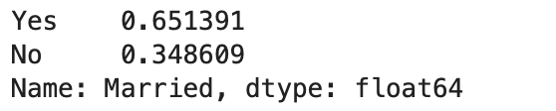
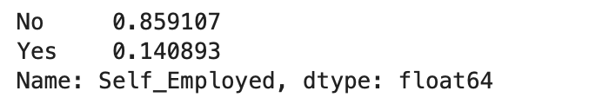
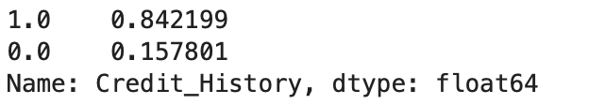
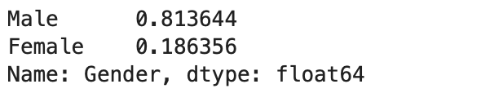
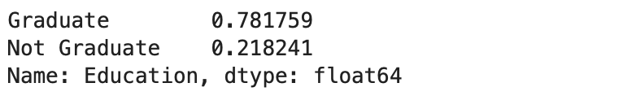
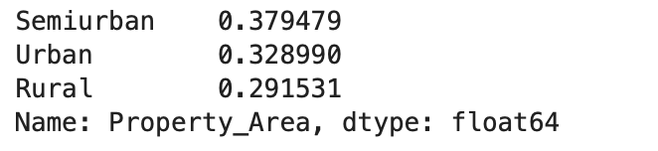
Data Understanding - Data Quality Cont’d
Further exploration of data shows that there is NO miscategorized data

Slide 11
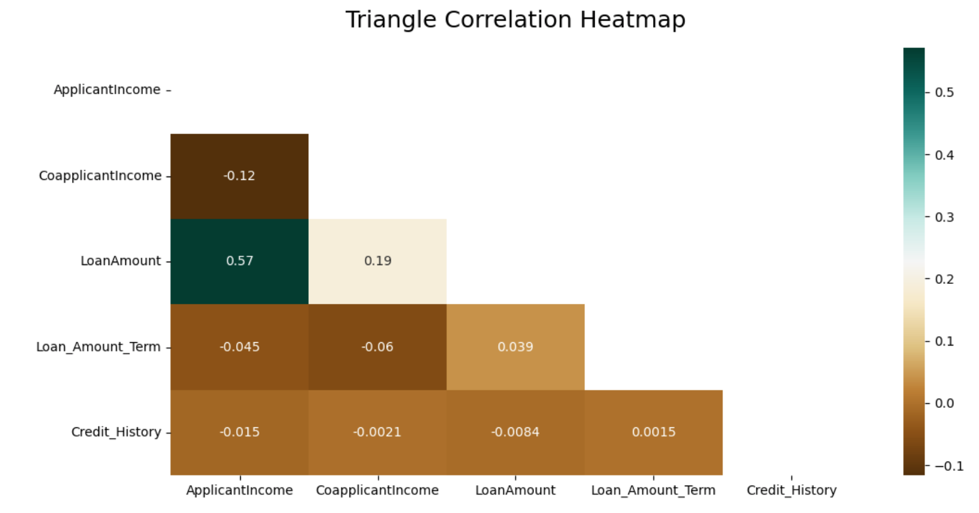
Data Understanding - Exploratory Data Analysis
Heatmap with correlation coefficients for all numerical independent variables are displayed below. There is NO correlation among numerical variables per correlation coefficients. (Statistically significant correlation should have coefficient of 0.7 and above)

Slide 12
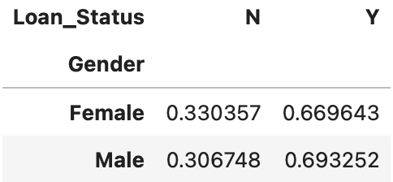
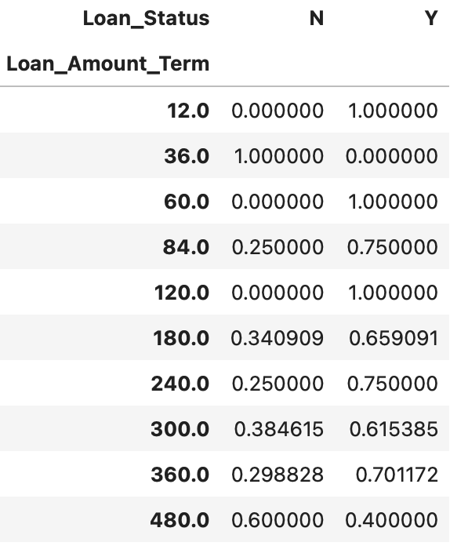
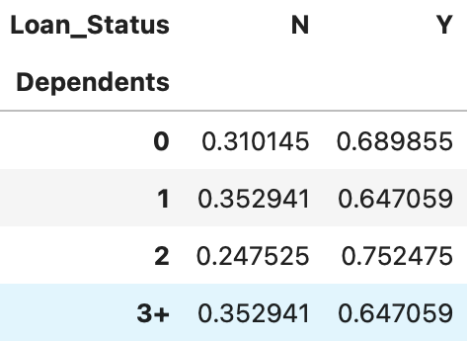
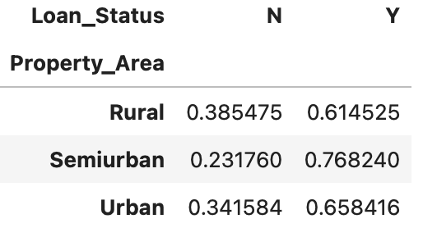
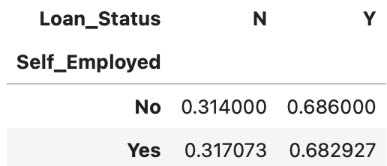
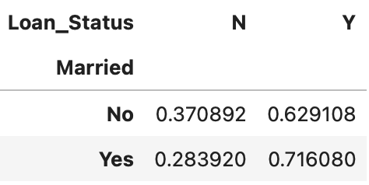
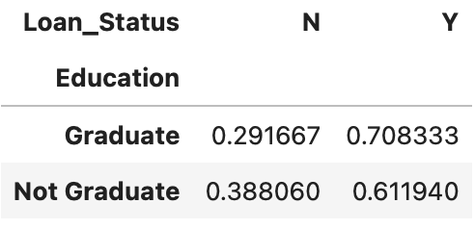
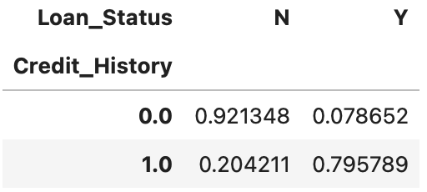
Data Understanding - Exploratory Data Analysis Cont’d
Cross-Tabulation analysis is performed to explore relationships between categorical independent variables and target variable, Loan_Status. We included Loan_Amount_Term and Credit_History here suspecting that they might have categorical trait.

Slide 13
Data Understanding - Exploratory Data Analysis Cont’d
There is no statistically correlations between all numerical variables
Analysis shows that Gender, Self_Employed, and Dependents do not have much effects on the target variable, Loan_Status
The only category under variable Property_Area that seems to have some impact on Loan_Status is Semiurban
Credit_History shows the strongest impact on Loan_Status per cross-tabulation analysis

Slide 14
Data Preparation
Dropped Variables: Through data exploration we came to the conclusion that we can drop the columns Loan_ID, Gender, Self_Employed, Dependents. Loan_ID is an identifier of each loan applicant and serves no purpose. Gender, Self_Employed, and Dependents are shown to have very little to no impact on the target variable, Loan_Status.
Treatment of Property_Area Variable: Property_Area was converted into a binary column with “Semiurban” as positive and “Rural”/”Urban” as negative.
Treatment of Missing Values: We dropped the rows that had NULL values. We have in fact tried multiple ways of treating null values: replacing null values with median, mode, or random values. After multiple loops of the CRISP process, we discovered dropping missing values provided the most accurate testing result.
Treatment of Outliers: We left the outliers as they are in place. We have in fact tried multiple ways of treating outliers: replacing outliers with median or mode or capping outliers with the IQR bounds. After multiple loops of the CRISP process, we discovered that all treatments of outliers reduce the accuracy of model prediction based on testing result and decided to leave the outliers as they are in place.

Slide 15
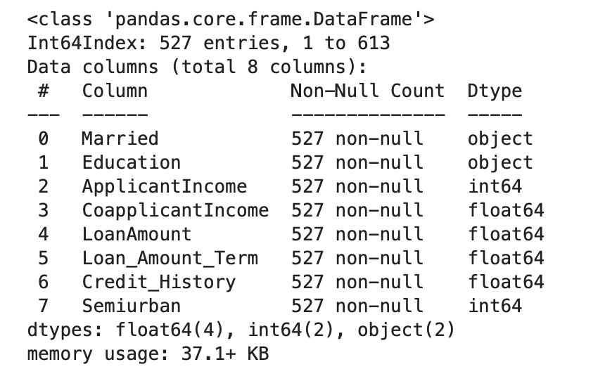
Data Preparation Cont’d
After applying all treatments of data from the Data Preparation Phase, we have 527 records available for modeling.
We split the 527 records available for modeling randomly into 60-40:
Training Set: 60% of all records available for modeling
Testing Set: 40% of all records available for modeling

Slide 16
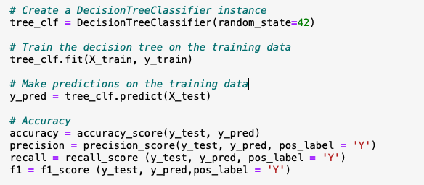
Modeling - Decision Tree
The target variable is categorical(yes/no) and it is not continuous. Therefore we will use two of the Machine Learning algorithms for our case.
Decision Tree
It is a collection of decision nodes, connected by branches, extending downward from the root node until terminating in leaf nodes. It creates a tree like structure which is easily readable which makes it easier for interpretation and understanding of the model. Since the loan approval process requires a lot of decisions to be made involving complex and diverse data type the decision tree model can handle these requirements and can also handle missing values and outliers that may be found in the data.
Decision Trees can handle both Categorical and Numerical values which is suitable for the loan approval process.

Slide 17
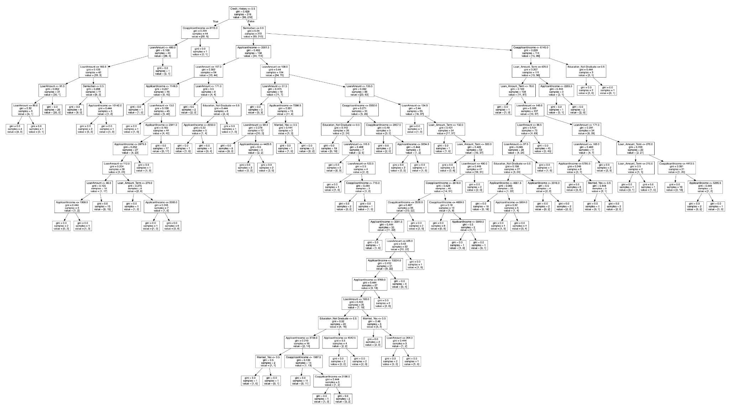
Modeling - Decision Tree Cont’d
The figure on the left shows us the full decision tree in its total depth of 20 and you can see that it is overfitting the model. Since this is the case we are going to prune the data to see how it fits.

Slide 18
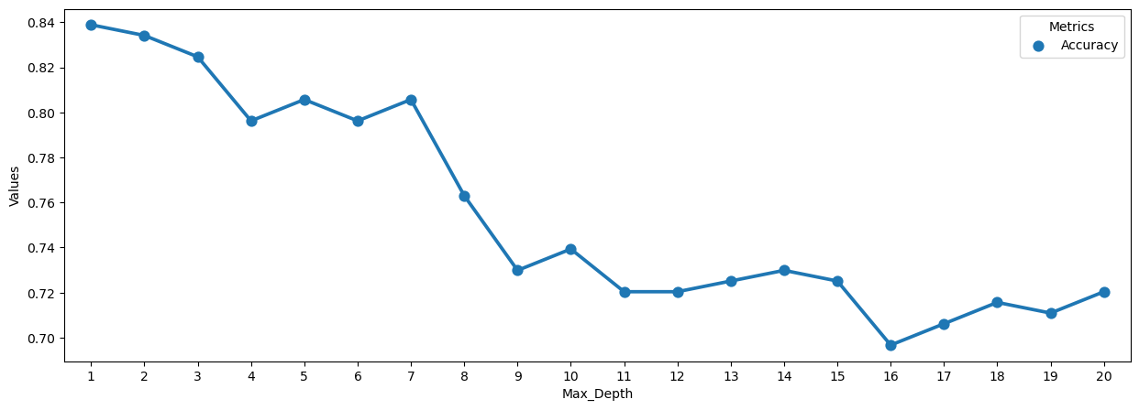
Modeling - Decision Tree Cont’d
The figure below shows us the accuracy of the model while pruning for depths 1 - 20.

Slide 19
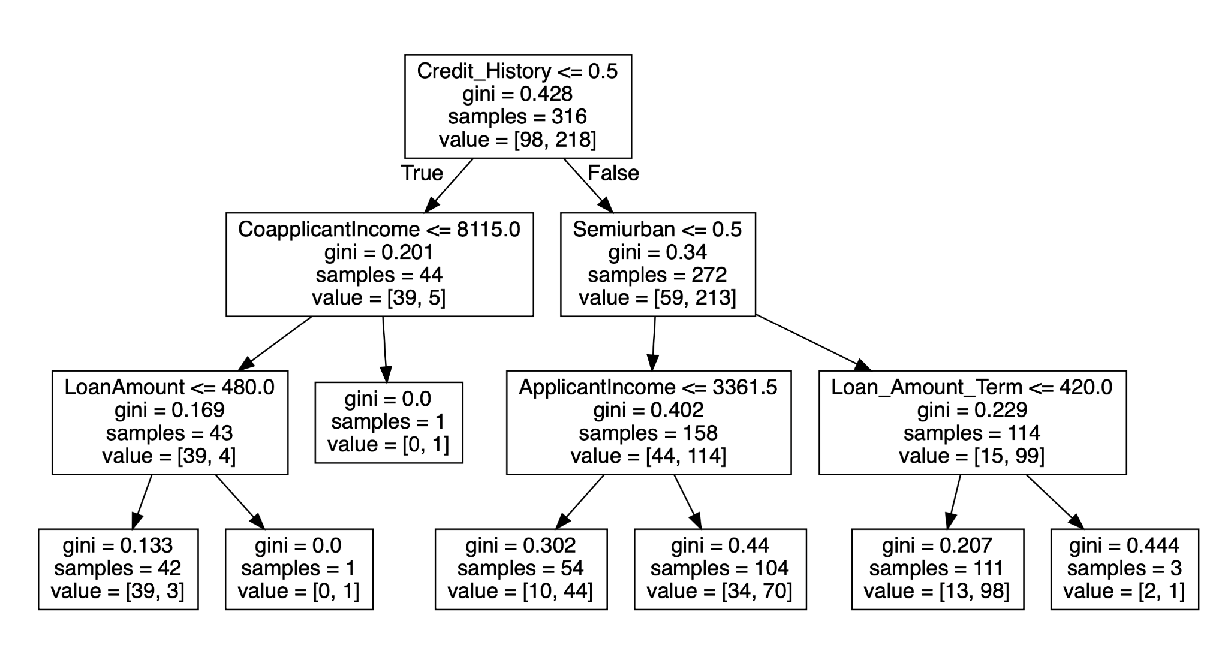
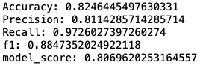
Modeling - Decision Tree Cont’d
The figures below show the final depth of 3 of the decision tree which we decided on based on the results obtained from pruning and the accuracy results that were obtained at depth 3.

Slide 20
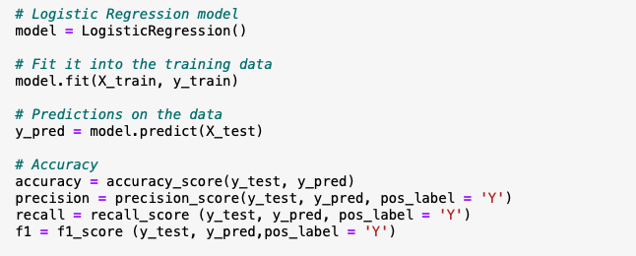
Modeling - Logistic Regression
2. Logistic Regression
It is statistical model used for classification and predictive analysis. It works well with independent variables and since the outcome is a probability the output is going to be binary. The loan approval process can get data intensive and the model can be scaled accordingly and does not require tuning. A model can be trained easily using logistic regression.
Logistic Regression can handle both Categorical and Numerical values which is suitable for the loan approval process.

Slide 21
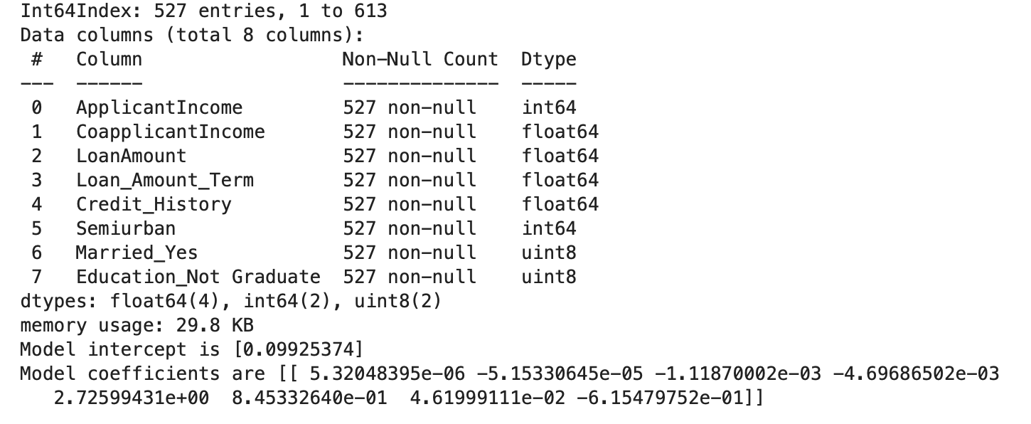
Modeling - Logistic Regression Cont’d
Three Elements of the Logistic Regression model are shown below:
Independent Variables used
Model Intercept
Model coefficients

Slide 22
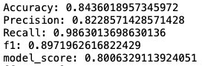
Evaluation
Logistic regression Model Scores
Decision Tree Model Scores
From evaluating both models’ performance, we should be able to make good predictions on the loan applications using the applicants’ information.
The Accuracy score is a model’s prediction success rate on the testing data set. The model_score is a model’s training score on the training data set. For both models, the accuracy score and model_score are close and therefore no sign of overfitting.
The F1 score ranges from 0 - 1. The higher the score the better the performance. Here both models have the scores closer to 1 which means it has great performance.
The Recall score shows the model’s tendency to capture all the positive cases. A high recall score shows that it has a smaller chance of missing the positive cases.
The Accuracy scores for both models, 84.36% for Logistic Regression and 82.46% for Decision Tree, indicate high successful rate of predicting whether to approve a loan applicant or not.

Slide 23
Deployment
This is the final phase of the CRISP-DM methodology. After the evaluating the results from both the models we will integrate the model for loan approval into the existing workflow of the bank(s).
The CRISP methodology that we used to run the Decision Tree and Logistic Regression models on the loan approval process for banks resulted in a higher percentage rate of accuracy. Logistic Regression had an accuracy of 84% and Decision Tree had an accuracy of 82% with no overfitting of the models.
Hence we can suggest that these models can be effectively used by banks to determine if a loan applicant’s application will be approved or not.

Slide 24
References
Methodology: Lecture Notes
Dataset: www.kaggle.com
Picture of Bank Counter: https://www.cnbc.com/select/best-personal-loans-from-big-banks/
Picture of Loan Application: https://www.sbdc.uh.edu/sbdc/The_Secrets_to_Loan_Approval_-_UH_SBDC.asp

